Slide 1
Fundamental Analysis Volatility Game

Slide 2

4 Golden Rules of Value Investing
Quant Investing Process
The Fund Manager- How to evaluate
1

Slide 3

Golden Rule- 1 Growth in Earnings
4 Golden Rules of Value Investing
Golden Rule- 1 Growth in Earnings
Do’s
Invest in Annual profit growth companies
Invest in Operating Profit growth companies
Invest in Quarterly profit that has exceeds the Annual Profit.
3 years CAGR of EPS
Don’t Invest in
Loss making Annual companies
If last quarter PAT is negative
Less Volume (Turnover) even if the company is in profit
2

Slide 4
Golden Rule-2 Management Efficiency & Efficient Business
Golden Rule-2 Management Efficiency & Efficient Business
Do’s
Invest in consistent and rising ROCE (Return on capital Employed)
Invest in consistent and rising ROE (Return on Equity)
Invest in high institution holding companies
Positive Free cash Flow companies
Regular Dividend Paying Companies
Growing Book value (Share holder Equity)
Don't Invest in
High debt to equity Ratio
Low interest coverage ratio
Low Current Ratio
Very High Promoter’s Pledge
Low credit rated companies
Free cash flow is important because it allows a company to pursue opportunities that enhance shareholder value. Without cash, it's tough to develop new products, make acquisitions, pay dividends and reduce debt.
3

Slide 5
Golden Rule -3 Performing Sectors, Companies MOAT & Competitive Advantage
Golden Rule -3 Performing Sectors, Companies MOAT & Competitive Advantage
Do’s
Companies has advantage over it peers when it has
ROIC (Return on invested capital) over and above cost of capital or WACC (weightedd average cost of capital)
High switching cost
Low Cost Provider
Strong Brand Name/ Intangible assets/Patents & Reputation
Economies of scale & Efficiency of scale
Company having monopoly or oligopoly situation in market.
Don’t invest in
Low growth Industry situation
Be cautious when there are too many companies in same business
*An economic moat is a competitive advantage that one company has over other companies in the same industry; this term was coined by Warren Buffett, a renowned investor and executive at Berkshire Hathaway. The wider the moat, the larger and more sustainable the competitive advantage of a firm.
4

Slide 6
Golden rule -4 Favorable Valuation
Do’s
Invest after Calculating intrinsic value by discounting Earnings, Free cash flow and book value.
Companies price performance is equal or more than the benchmark Index.
Invest in Low PE Ratio & Low PB ratio
Don’t invest in
High price to book value ratio
High PE ratio Companies
High Peg ratio
5

Slide 7
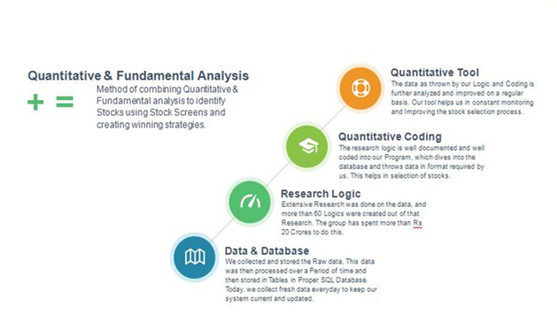
Our Quant Investing Process
6

Slide 8

This PPT is prepared by Mr Shailesh Saraf
Mr. Shailesh Saraf-Managing Director - Dynamic Equities Pvt Limited
Mr. Saraf has an experience of nearly 20 years in the financial market especially in areas related to capital & derivatives market operations, trading, research and management. Mr. Shailesh Saraf has learnt international best practices and continues to strive for nothing but the best in terms of both moral and material growth.
Our in-house research team, an initiative of Mr. Shailesh Saraf, is dedicatedly involved in guiding our clients and arbitrage partners.
By intensive research and back testing of market data, strategies evolve from time to time. Our research desk is technologically robust, continuously upgraded and equipped with latest charting and data software. Our research team is spearheaded and mentored by Mr. Shailesh Saraf himself.
He regularly conducts Webinars on Investing.com and holds Seminars across different cities in India.
7

